Slide 1
Introduction to Transaction Processing Concepts and Theory

Slide 2
Introduction
Transaction
Describes logical unit of database processing
Transaction processing systems
Systems with large databases and hundreds of concurrent users
Require high availability and fast response time

Slide 3
20.1 Introduction to Transaction Processing
Single-user DBMS
At most one user at a time can use the system
Example: home computer
Multiuser DBMS
Many users can access the system (database) concurrently
Example: airline reservations system

Slide 4
Introduction to Transaction Processing (cont’d.)
Multiprogramming
Allows operating system to execute multiple processes concurrently
Executes commands from one process, then suspends that process and executes commands from another process, etc.

Slide 5
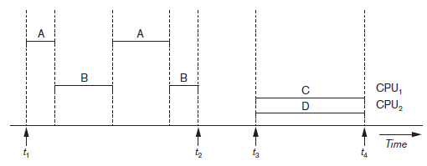
Introduction to Transaction Processing (cont’d.)
Interleaved processing
Parallel processing
Processes C and D in figure below
Figure 20.1 Interleaved processing versus parallel processing of concurrent transactions

Slide 6
Transactions
Transaction: an executing program
Forms logical unit of database processing
Begin and end transaction statements
Specify transaction boundaries
Read-only transaction
Read-write transaction

Slide 7
Database Items
Database represented as collection of named data items
Size of a data item called its granularity
Data item
Record
Disk block
Attribute value of a record
Transaction processing concepts independent of item granularity

Slide 8
Read and Write Operations
read_item(X)
Reads a database item named X into a program variable named x
Process includes finding the address of the disk block, and copying to and from a memory buffer
write_item(X)
Writes the value of program variable x into the database item named X
Process includes finding the address of the disk block, copying to and from a memory buffer, and storing the updated disk block back to disk

Slide 9
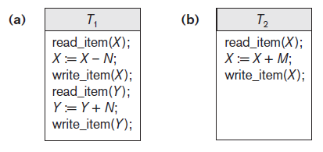
Read and Write Operations (cont’d.)
Read set of a transaction
Set of all items read
Write set of a transaction
Set of all items written
Figure 20.2 Two sample transactions (a) Transaction T1 (b) Transaction T2

Slide 10
DBMS Buffers
DBMS will maintain several main memory data buffers in the database cache
When buffers are occupied, a buffer replacement policy is used to choose which buffer will be replaced
Example policy: least recently used

Slide 11
Concurrency Control
Transactions submitted by various users may execute concurrently
Access and update the same database items
Some form of concurrency control is needed
The lost update problem
Occurs when two transactions that access the same database items have operations interleaved
Results in incorrect value of some database items

Slide 12
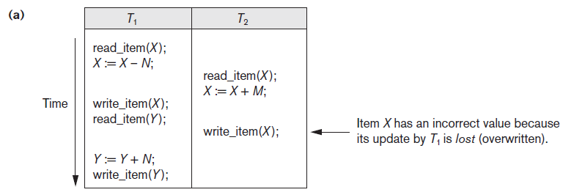
The Lost Update Problem
Figure 20.3 Some problems that occur when concurrent execution is uncontrolled (a) The lost update problem

Slide 13
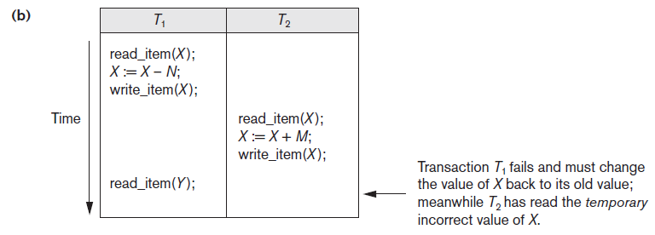
The Temporary Update Problem
Figure 20.3 (cont’d.) Some problems that occur when concurrent execution is uncontrolled (b) The temporary update problem

Slide 14
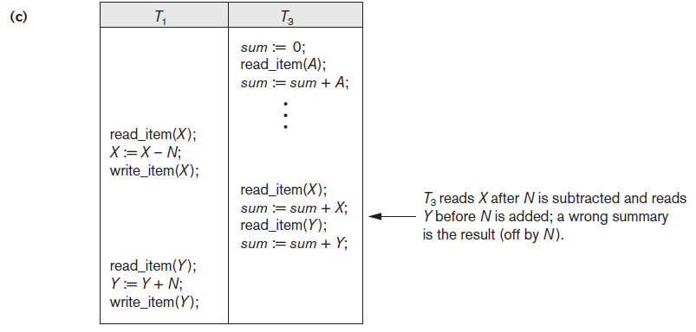
The Incorrect Summary Problem
Figure 20.3 (cont’d.) Some problems that occur when concurrent execution is uncontrolled (c) The incorrect summary problem

Slide 15
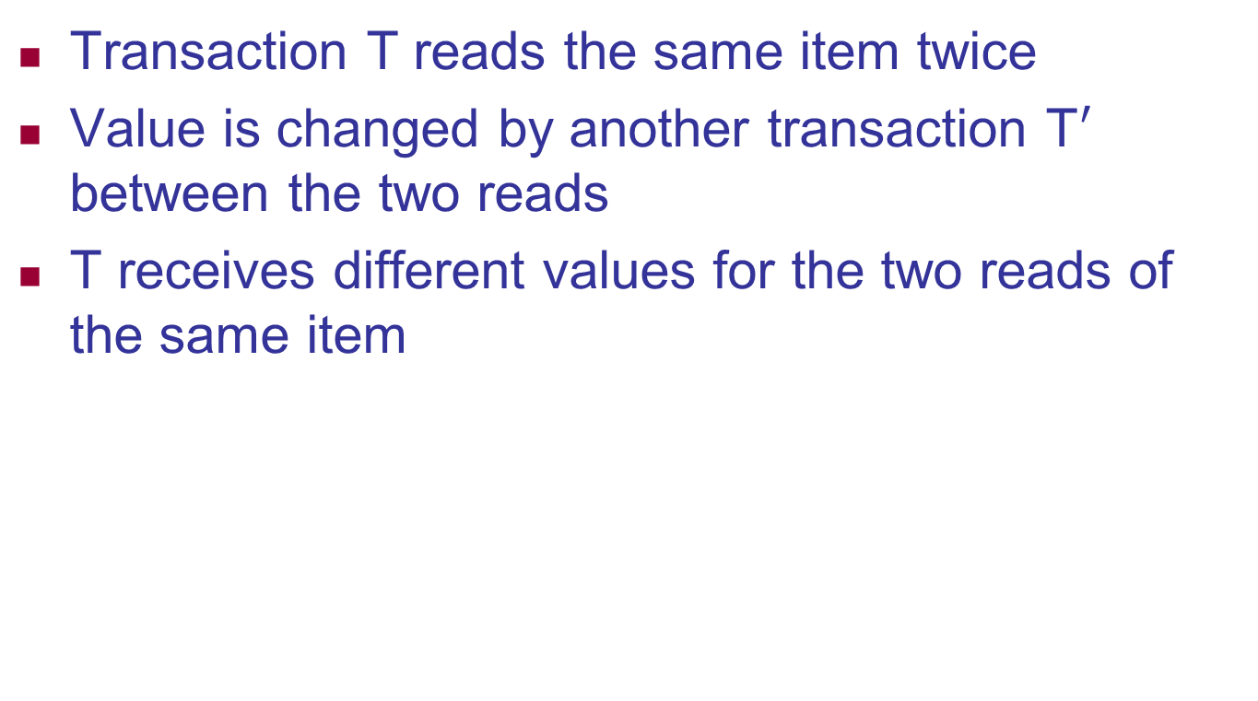
The Unrepeatable Read Problem
Transaction T reads the same item twice
Value is changed by another transaction T$′$ between the two reads
T receives different values for the two reads of the same item
T1 | T2
R(x)
 | R(x)
W(x)
 | R(x)

Slide 16
Why Recovery is Needed
Committed transaction
Effect recorded permanently in the database
Aborted transaction
Does not affect the database
Types of transaction failures
Computer failure (system crash)
Transaction or system error
Local errors or exception conditions detected by the transaction

Slide 17
Why Recovery is Needed (cont’d.)
Types of transaction failures (cont’d.)
Concurrency control enforcement
Disk failure
Physical problems or catastrophes
System must keep sufficient information to recover quickly from the failure
Disk failure or other catastrophes have long recovery times

Slide 18
20.2 Transaction and System Concepts
System must keep track of when each transaction starts, terminates, commits, and/or aborts
BEGIN_TRANSACTION
READ or WRITE
END_TRANSACTION
COMMIT_TRANSACTION
ROLLBACK (or ABORT)

Slide 19
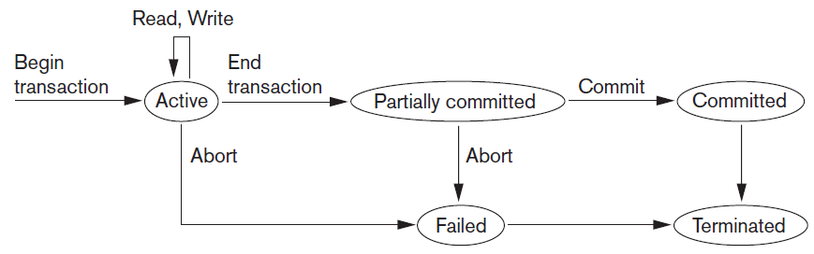
Transaction and System Concepts (cont’d.)
Figure 20.4 State transition diagram illustrating the states for transaction execution

Slide 20
The System Log
System log keeps track of transaction operations
Sequential, append-only file
Not affected by failure (except disk or catastrophic failure)
Log buffer
Main memory buffer
When full, appended to end of log file on disk
Log file is backed up periodically
Undo and redo operations based on log possible

Slide 21
Commit Point of a Transaction
Occurs when all operations that access the database have completed successfully
And effect of operations recorded in the log
Transaction writes a commit record into the log
If system failure occurs, can search for transactions with recorded start_transaction but no commit record
Force-writing the log buffer to disk
Writing log buffer to disk before transaction reaches commit point

Slide 22
DBMS-Specific Buffer Replacement Policies
Page replacement policy
Selects particular buffers to be replaced when all are full
Domain separation (DS) method
Each domain handles one type of disk pages
Index pages
Data file pages
Log file pages
Number of available buffers for each domain is predetermined

Slide 23
DBMS-Specific Buffer Replacement Policies (cont’d.)
Hot set method
Useful in queries that scan a set of pages repeatedly
Does not replace the set in the buffers until processing is completed
The DBMIN method
Predetermines the pattern of page references for each algorithm for a particular type of database operation
Calculates locality set using query locality set model (QLSM)

Slide 24
20.3 Desirable Properties of Transactions
ACID properties
Atomicity
Transaction performed in its entirety or not at all
Consistency preservation
Takes database from one consistent state to another
Isolation
Not interfered with by other transactions
Durability or permanency
Changes must persist in the database

Slide 25
Desirable Properties of Transactions (cont’d.)
Levels of isolation
Level 0 isolation does not overwrite the dirty reads of higher-level transactions
Level 1 isolation has no lost updates
Level 2 isolation has no lost updates and no dirty reads
Level 3 (true) isolation has repeatable reads
In addition to level 2 properties
Snapshot isolation

Slide 26
20.4 Characterizing Schedules Based on Recoverability
Schedule or history
Order of execution of operations from all transactions
Operations from different transactions can be interleaved in the schedule
Total ordering of operations in a schedule
For any two operations in the schedule, one must occur before the other

Slide 27
Characterizing Schedules Based on Recoverability (cont’d.)
Two conflicting operations in a schedule
Operations belong to different transactions
Operations access the same item X
At least one of the operations is a write_item(X)
Two operations conflict if changing their order results in a different outcome
Read-write conflict
Write-write conflict

Slide 28








Characterizing Schedules Based on Recoverability (cont’d.)
Recoverable schedules
Recovery is possible
Nonrecoverable schedules should not be permitted by the DBMS
No committed transaction ever needs to be rolled back
Cascading rollback may occur in some recoverable schedules
Uncommitted transaction may need to be rolled back

Slide 29
Characterizing Schedules Based on Recoverability (cont’d.)
Cascadeless schedule
Avoids cascading rollback
Strict schedule
Transactions can neither read nor write an item X until the last transaction that wrote X has committed or aborted
Simpler recovery process
Restore the before image

Slide 30




Characterizing Schedules Based on Recoverability - EXAMPLE
Determine whether the schedule is strict, cascadeless, recoverable, or non-recoverable.
S1: r1(X); w1(X); r1(Y); w1(Y); r2(X); C1; w2(X); C2;
Ans: RECOVERABLE Schedule
S2: r1(X); w1(X); r1(Y); w1(Y); r2(X); w2(X); C2; C1;
Ans: NON-RECOVERABLE Schedule
S3: r1(X); r2(X); w1(X); r1(Y); w1(Y); w2(X); C1; C2;
Ans: CASCADELESS Schedule
S4: r1(X); r2(X); w1(X); r1(Y); w1(Y); C1; w2(X); C2;
Ans: STRICT Schedule

Slide 31
20.5 Characterizing Schedules Based on Serializability
Serializable schedules
Always considered to be correct when concurrent transactions are executing
Places simultaneous transactions in series
Transaction T₁ before T₂, or vice versa

Slide 32
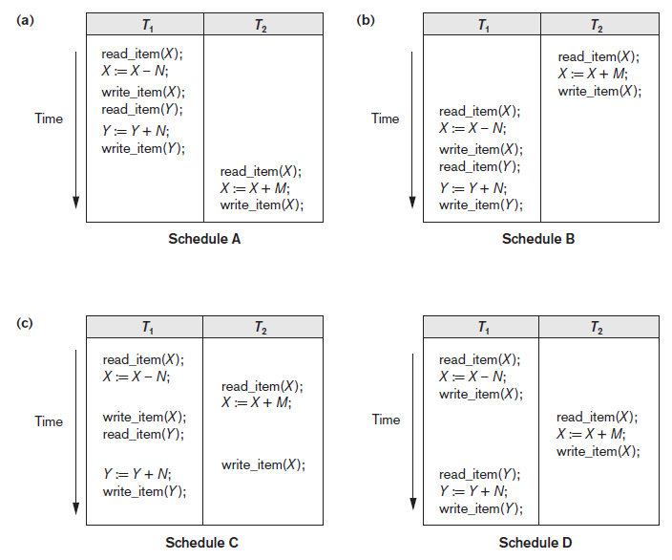
Figure 20.5 Examples of serial and nonserial schedules involving transactions T1 and T2 (a) Serial schedule A: T1 followed by T2 (b) Serial schedule B: T2 followed by T1 (c) Two nonserial schedules C and D with interleaving of operations

Slide 33
Characterizing Schedules Based on Serializability (cont’d.)
Problem with serial schedules
Limit concurrency by prohibiting interleaving of operations
Unacceptable in practice
Solution: determine which schedules are equivalent to a serial schedule and allow those to occur
Serializable schedule of n transactions
Equivalent to some serial schedule of same n transactions

Slide 34
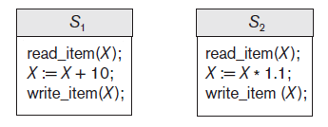
Characterizing Schedules Based on Serializability (cont’d.)
Result equivalent schedules
Produce the same final state of the database
May be accidental
Cannot be used alone to define equivalence of schedules
Figure 20.6 Two schedules that are result equivalent for the initial value of X = 100 but are not result equivalent in general

Slide 35
Characterizing Schedules Based on Serializability (cont’d.)
Conflict equivalence
Relative order of any two conflicting operations is the same in both schedules
Serializable schedules
Schedule S is serializable if it is conflict equivalent to some serial schedule S’.

Slide 36
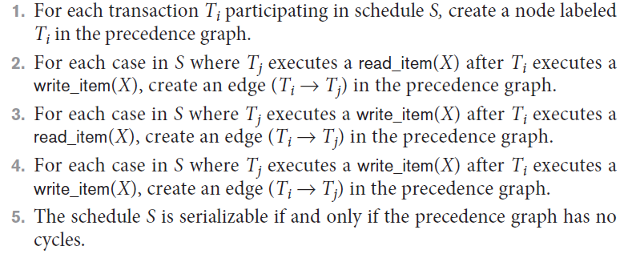


Characterizing Schedules Based on Serializability (cont’d.)
Testing for serializability of a schedule
Algorithm 20.1 Testing conflict serializability of a schedule S

Slide 37








Practice problem
T1 | T2 | T3
R(x)
 | R(Y)
 |  | R(Y)
 | W(Y)
W(X)
 |  | W(X)
 | R(X) W(X)
T2
NO CYCLE
T1
T3
Notes:
T1 t3 t2

Slide 38





Conflict serializable?
T1 | T2 | T3
R(A)
 | W(A)
 |  | R(C)
 |  | W(C)
 | W(B)
W(A)
Notes:
4 POSSIBLE
T1 T2 T3
T1 T3 T2
T3 T1 T2
T1 T3 T2

Slide 39
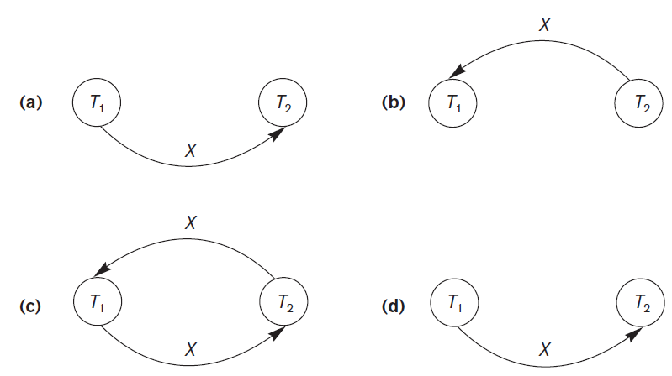
Characterizing Schedules Based on Serializability (cont’d.)
Figure 20.7 Constructing the precedence graphs for schedules A to D from Figure 20.5 to test for conflict serializability (a) Precedence graph for serial schedule A (b) Precedence graph for serial schedule B (c) Precedence graph for schedule C (not serializable) (d) Precedence graph for schedule D (serializable, equivalent to schedule A)

Slide 40
How Serializability is Used for Concurrency Control
Being serializable is different from being serial
Serializable schedule gives benefit of concurrent execution
Without giving up any correctness
Difficult to test for serializability in practice
Factors such as system load, time of transaction submission, and process priority affect ordering of operations
DBMS enforces protocols
Set of rules to ensure serializability

Slide 41






View Equivalence and View Serializability
View equivalence of two schedules
As long as each read operation of a transaction reads the result of the same write operation in both schedules, the write operations of each transaction must produce the same results
Read operations said to see the same view in both schedules
View serializable schedule
View equivalent to a serial schedule

Slide 42





View Equivalent
Initial read same
Intermediate read same
Final writes same
T1 | T2
R(A)
W(A)
 | R(A)
 | W(A)
R(B)
W(B)
 | R(B)
 | W(B)
T1 | T2
R(A)
W(A)
R(B)
W(B)
 | R(A)
 | W(A)
 | R(B)
 | W(B)
Notes:
YES CONFLICT AND VIEW SERIALIZABLE

Slide 43






Practice Problem
T1 | T2 | T3 | T4
 | R(X)
 |  | W(X) C
W(X) C
 | W(Y) R(Z) C
 |  |  | R(X) R(Y) C
Notes:
Check conflict serializability?

Slide 44
View Equivalence and View Serializability (cont’d.)
Conflict serializability similar to view serializability if constrained write assumption (no blind writes) applies
Unconstrained write assumption
Value written by an operation can be independent of its old value

Slide 45
20.6 Transaction Support in SQL
No explicit Begin_Transaction statement
Every transaction must have an explicit end statement
COMMIT
ROLLBACK
Access mode is READ ONLY or READ WRITE
Diagnostic area size option
Integer value indicating number of conditions held simultaneously in the diagnostic area

Slide 46
The four standard isolation levels are:
Read Uncommitted: This is the lowest level of isolation where a transaction can see uncommitted changes made by other transactions. This can result in dirty reads, non-repeatable reads, and phantom reads.
Read Committed: In this isolation level, a transaction can only see changes made by other committed transactions. This eliminates dirty reads but can still result in non-repeatable reads and phantom reads.
Repeatable Read: This isolation level guarantees that a transaction will see the same data throughout its duration, even if other transactions commit changes to the data. However, phantom reads are still possible.
Serializable: This is the highest isolation level where a transaction is executed as if it were the only transaction in the system. All transactions must be executed sequentially, which ensures that there are no dirty reads, non-repeatable reads, or phantom reads.
Notes:
A phantom read occurs when, in the course of a transaction, two identical queries are executed, and the collection of rows returned by the second query is different from the first.

Slide 47
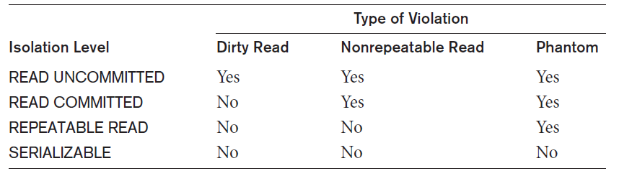
Transaction Support in SQL (cont’d.)
Isolation level option
Dirty read
Nonrepeatable read
Phantoms
Table 20.1 Possible violations based on isolation levels as defined in SQL

Slide 48
Transaction Support in SQL (cont’d.)
Snapshot isolation
Used in some commercial DBMSs
Transaction sees data items that it reads based on the committed values of the items in the database snapshot when transaction starts
Ensures phantom record problem will not occur

Slide 49
20.7 Summary
Single and multiuser database transactions
Uncontrolled execution of concurrent transactions
System log
Failure recovery
Committed transaction
Schedule (history) defines execution sequence
Schedule recoverability
Schedule equivalence
Serializability of schedules

